Slide 1
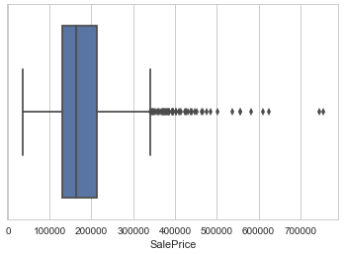
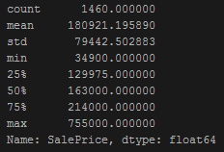
Ames housing Data
In our data, the SalePrice is the target variable. My intuition, based off of the "Location, Location, Location" saying, was that categorical features such as the neighborhood and proximity to key roads, will be more important.

Slide 2
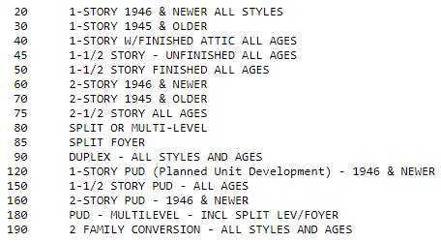
Data Cleaning
There were 81 features, 43 of which were non-numerical.
One of the numerically encoded variables was in fact categorical.

Slide 3
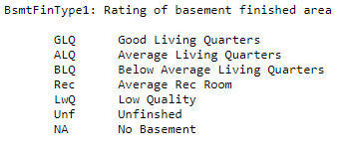
Data Cleaning
Many of the variables were subjective quality ratings, which could be ordered and ranked. However, some of these were open to interpretation:
I considered this to be ordered, but reasonable people could disagree.

Slide 4
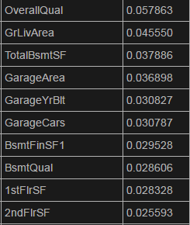

Random Forest Model
For the actual modeling, I started with a Random Forest, which we know from class to have the greatest predictive power.
Random Forest also has the advantage of being able to calculate feature importance.
Oob score:
RMSE:
Tuning the max features brought this down to
around 28,399.

Slide 5
Linear Regression
That done, the problem with random forest is that it is less interpretable. It would be more useful to a homeowner to have a set of betas to know how to improve their house so as to increase the value.
RMSE with all features comes out to 30,117.

Slide 6

Linear Regression
Problems- intercepts and coefficients:
Some of these are clear outliers- e.g. there is only one house with a tennis court.

Slide 7
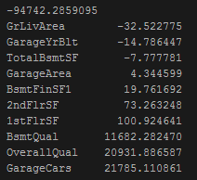
Linear Regression
Do another regression, but with only the “important” features as determined in the Random Forest. Resulting coefficients:
These are more sensible, but also less actionable. It is difficult to add square footage to your house, easier to pave a driveway.

